Slide 1
Discussion Forum for BIT
Purva Dhopade (2046491245034)
Ashwini Ukhalkar (2046491245008)
Shreya Chinchmalatpure(2046491245048)
Mrs. Urvashi Pote
Assisstant Professor

Slide 2
1. Introduction
A discussion forum is a web-based application which provides a medium to share knowledge about what you’ve learned from your own studies and experiences.
It allows users to share their thoughts and opinions, ask questions, and gain insights from other members of the forum. It is a great way for people to connect and learn from one another.
Online forums can be used for many purposes, such as helping students to review material before an exam, engaging students in discussion .
Group discussion forums are often used in educational settings, as they can be a great way for students to interact and collaborate. They can also be used to facilitate debates and discussions. It is a great way for people to connect and learn from one another.

Slide 3
2. Objectives & Scope of Project
Discussion Forum for BIT enables you to create an open and collaborative environment where members can exchange ideas and learn from each other.
Three different stakeholders Admin, Faculties and students each of whom would play different roles while interacting with the system.
Discussion Forum provides a space for members to share resources, such as links to articles, videos, and other materials.
All the stakeholders will have the facility to ask questions on the forum and get the desired response.
The user can also find previously answered questions with the help of tags.
Weekly Blogs, Activities or events will be posted by admin and moderator for guiding students.

Slide 4



3. Stakeholders
Admin
Faculty
Students

Slide 5
4. Literature Survey.
A Design-Based Study for Development of a Model for a Successful Online Discussion Forum
This article reviews how the current COVID-19 pandemic has revealed the curtains of many important tools that can be used for online learning. Online discussion forum (ODF) being one of them .The use of ODF has been identified as an important activity for engaging students besides on the educational units or assignments. Many educational institutions have shifted to online learning as it helps in fostering the students’ engagement and learning.
Effectiveness of Using Online Discussion Forum
This article discusses benefits of using online discussion forums and peer to peer learning for enhancing student learning techniques. It identifying the use of technology tools available in higher education and deploying them effectively in the classroom in order to improve student learning strategies.
It also mentions how higher institutions have started adopting hybrid or blended models of education that combines classroom and distributed learning environments. Online discussion forums are considered an extension of traditional learning methods for knowledge construction and self-assessment.

Slide 6
4. Literature Survey.
Promoting college students’ systems thinking in asynchronous discussions: Encouraging students initiating questions.
Discussion forum support students’ development of critical thinking. The forum makes ideas accessible to all learners through displaying ideas in a communal space. ODF helps in clarifying quries, linking different ideas, and widening discussions by asking more questions . Students engaged with progressive discussions in the forum, such as responding to the teachers’ prompting questions by elaborating and extending ideas, reflecting upon their learning process .
Outcomes of Chat and Discussion Board Use in Online Learning: A Research Synthesis
Online Discussion Forums can be particularly for students, as these communication connections are often students’ only means of connecting with each other and sharing ideas in an open forum. For example, a study by Chapman and Stone (2007) showed that if a student who posted to the board received positive responses from other students, that student felt obligated to respond to those positive posts. This ultimately allowed students to interact in various ways via the discussion board.

Slide 7
5. Proposed Solution
Discussion Forum for BIT is a technical Forum designed specially for our Institute.
There will be three type of users who will interact with this system and control the various activity.
These three users will be:
Users
Admin
Faculties
Students
Their would be faculty for each subject called the moderator.
Have the authority to register the users.
Approve questions, write blogs, update the events.
Keep a check on the active users.
Admin will keep track on various activities of users and the moderators.
Displaying the upcoming events on the forum.
Displaying the upcoming events on the forum.
Keep a check on the active users.
Ask questions on the forum, get their answers
Comments to existing posts,
View trending questions and upcoming events

Slide 8
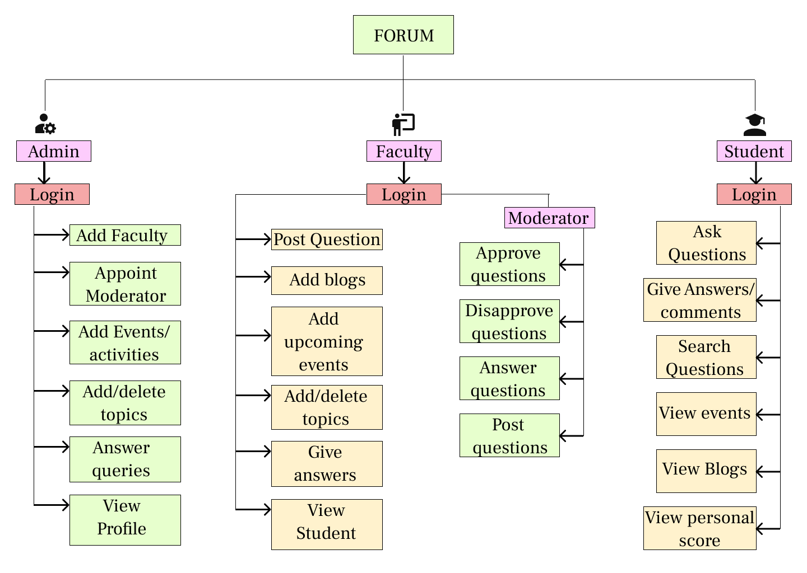
6. Process Flow

Slide 9
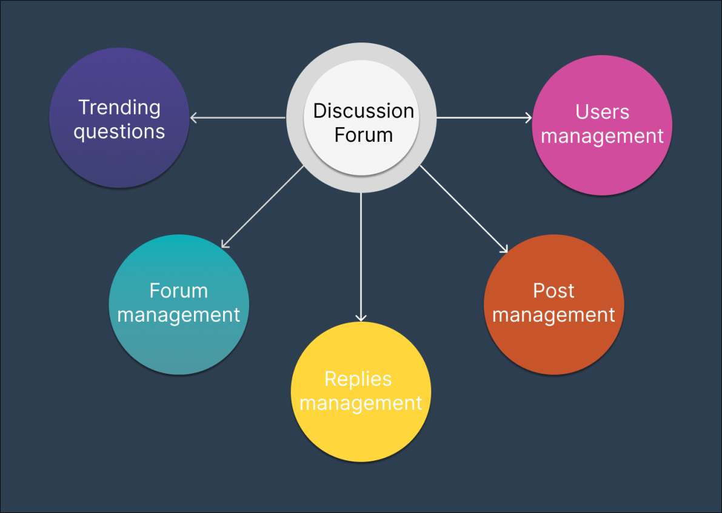
6. Functional Diagram

Slide 10
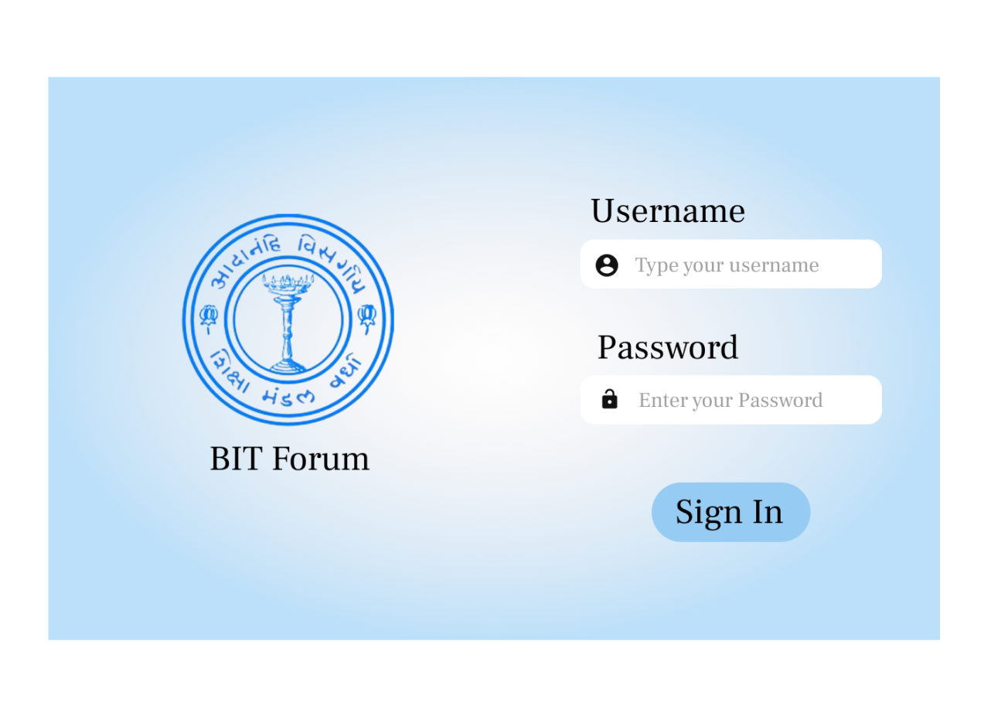
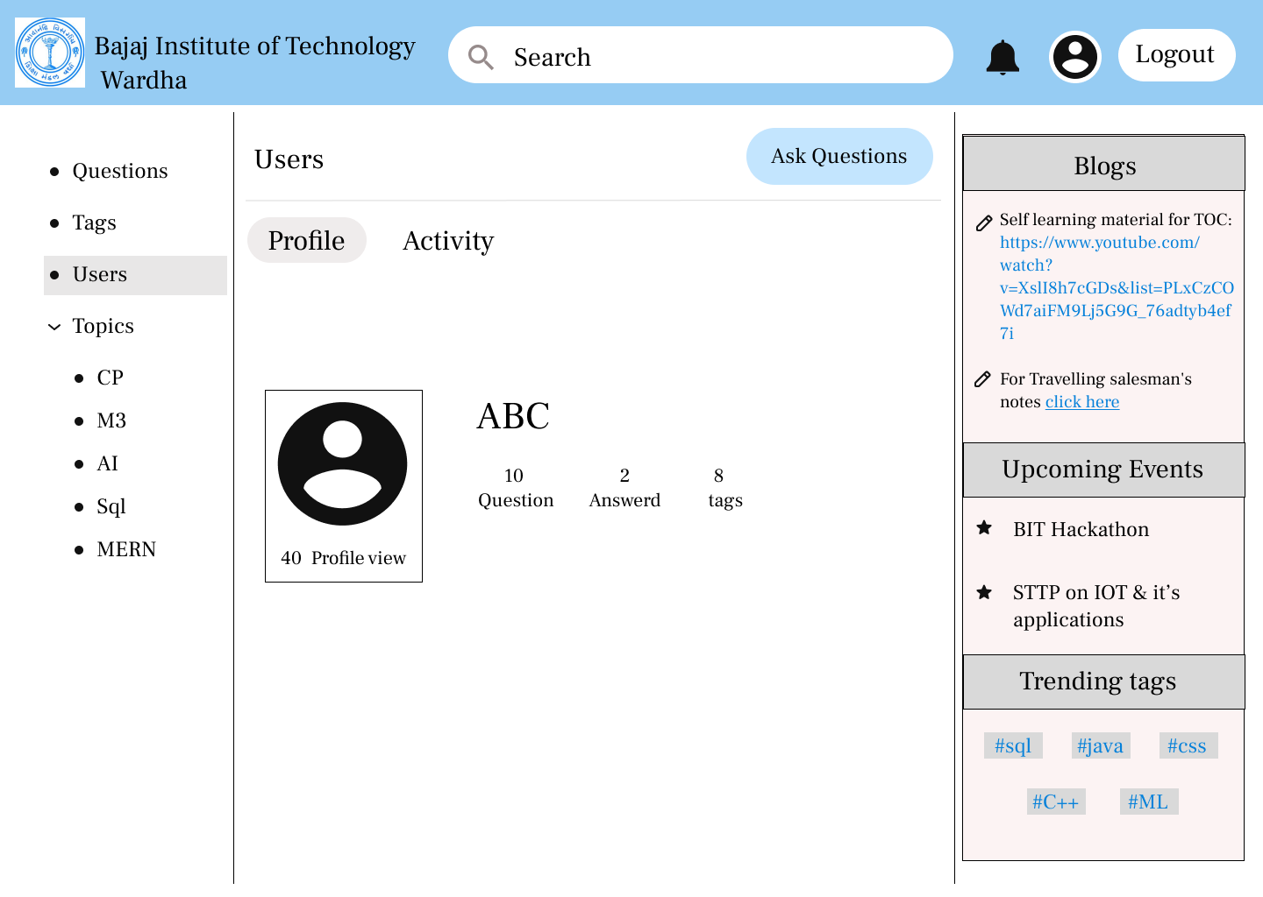
6. Snapshots of Projects
Sign in Page
Profile Page

Slide 11
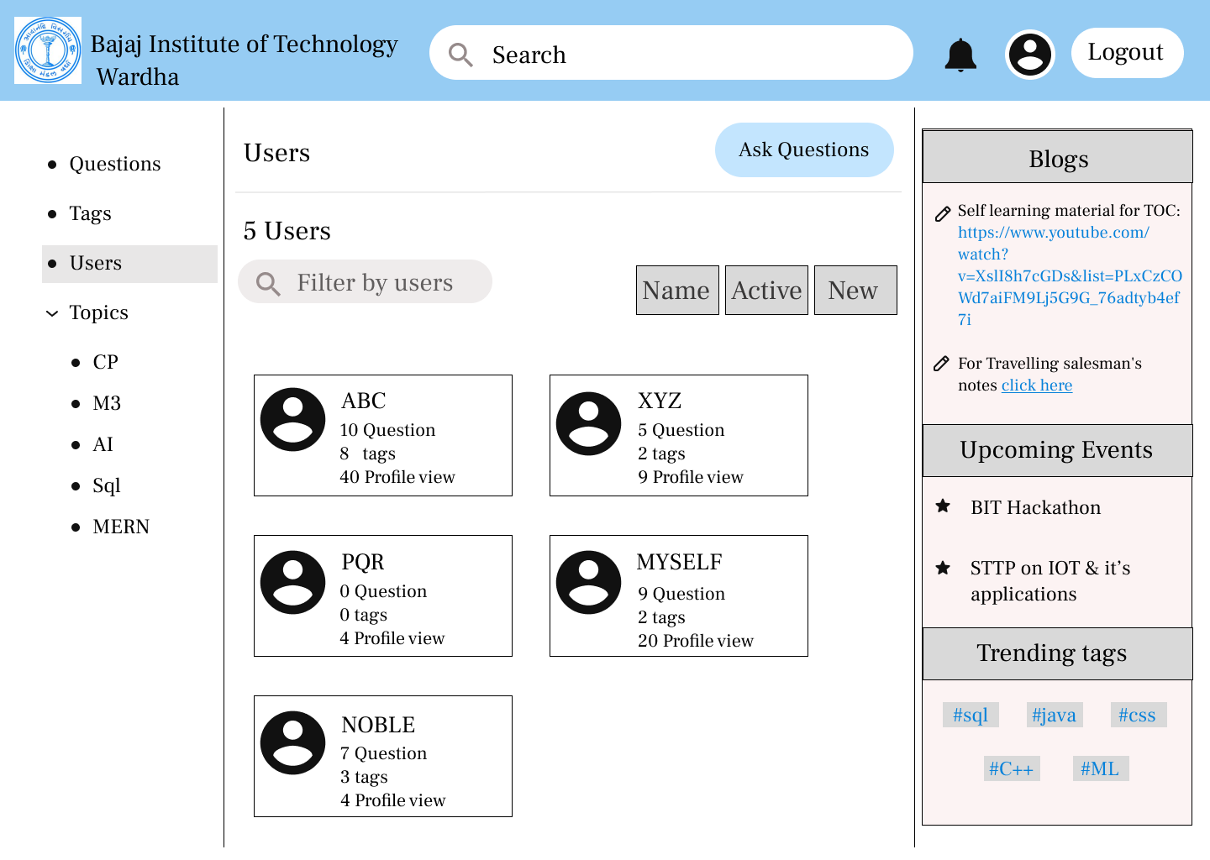
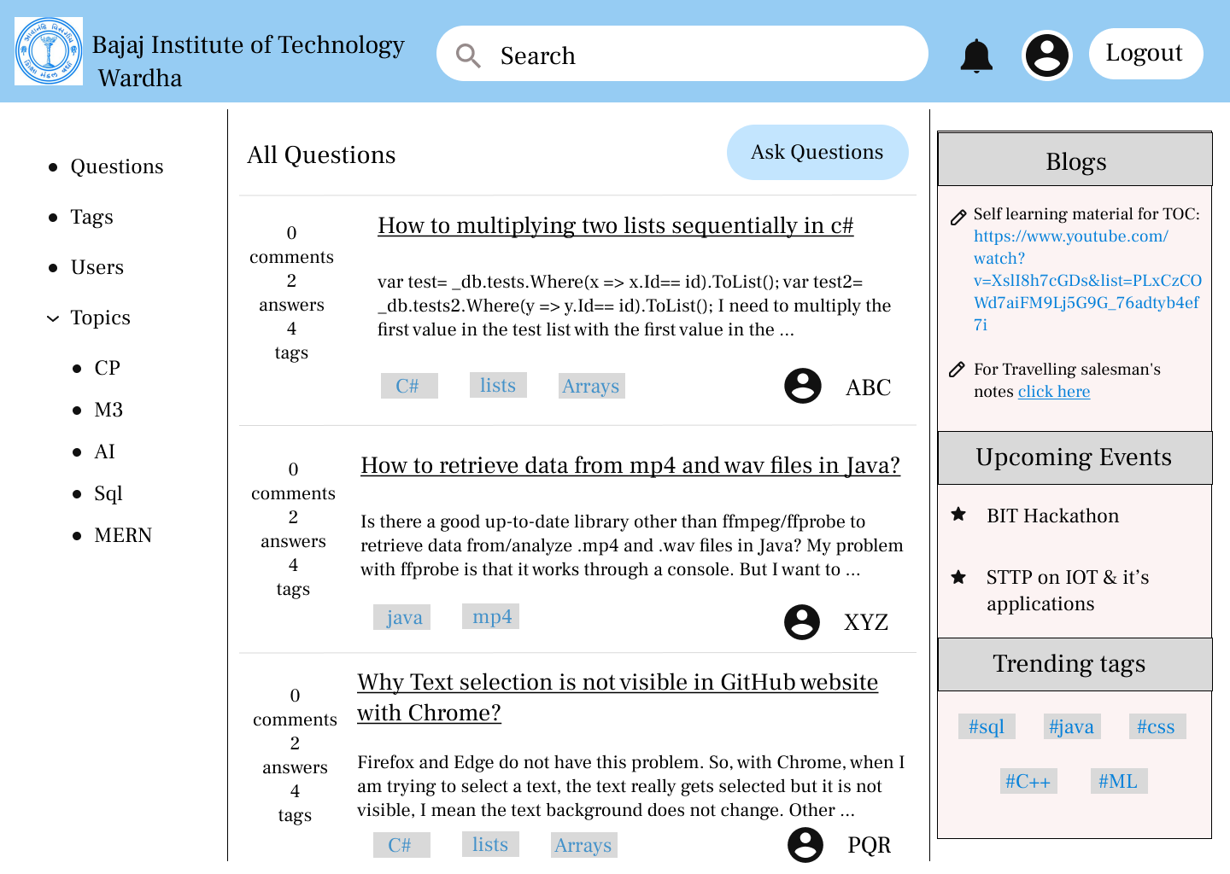
6. Snapshots of Projects
Front Page

Slide 12

7. Technologies Used

Slide 13
9. Conclusion
The Discussion Forum for BIT will ultimately help students to resolve their queries, also having the facility to directly ask questions to their faculties and peers.
Group discussion forums are a great way for peer to peer communication, exchange ideas, and learning from one another. They can also be used to facilitate debates and discussions, allowing people to think critically and share their perspectives. Moderator(faculties) also help in ensuring that conversations remain respectful and on-topic.
Group discussion forums play a crucial role in fostering open communication and meaningful exchanges of ideas. Whether in person or online, group discussion forums have the potential to make a positive impact on individuals and communities alike.

Slide 14
10. References
Effectiveness of Using Online Discussion Forum
(https://www.hindawi.com/journals/edri/2014/589860/)
A Design-Based Study for Development of a Model for a Successful Online Discussion Forum
(https://www.igi-global.com/gateway/article/full-text-pdf/294574)
Promoting college students’ systems thinking in asynchronous discussions: Encouraging students initiating questions
(https://www.frontiersin.org/articles/10.3389/fpsyg.2022.1028655/full#ref8)
Outcomes of Chat and Discussion Board Use in Online Learning: A Research Synthesis
(https://files.eric.ed.gov/fulltext/EJ985399.pdf)

Slide 15
Thank You.

